Slide 1

DEPARTMENT OF COMPUTER SCIENCE AND ENGINEERING
19CSE100-PROBLEM SOLVING AND ALGORITHM THINKING
.
VAISHNAVI S-1006533
SUSEELA-1023837
HARSHA-2003929
VIGNESH-1031109
VINAY-1011690
IPL SCHEDULER

Slide 2
OVERVIEW
Preface – How many teams participating and what are they.
Match - How many matches each team plays.
Venues – Schedule and play ground.
Playoffs – Top 4 teams qualified.
Final – Winner 1 + Winner 2
Special awards – for top events like ( purple cap , orange cap, Game changer , Fair play , perfect catch etc...)

Slide 3
PREFACE
In this we are going to see how the IPL is scheduled and how the working system goes behind this.
Basically IPL consists of 8 teams in total and play 56 matches. Each team will play 14 matches i.e, 7 in home town and 7 away. Each team gets to play 1 match in home ground and other away against each opponent.
The winning teams will be gaining +2 points and run rate accordingly when they win.

Slide 4
And finally the four teams that is in the top four position of the table will be qualified for qualifiers.
There will be 2 qualifiers and a eliminator match.
Qualifier 1 , qualifier 2 and eliminator.
The winner of the finals will be the champions of the season.

Slide 5
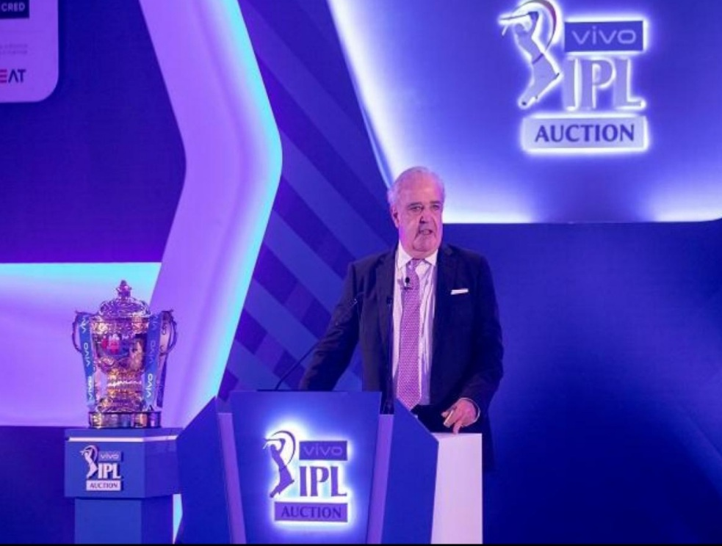
AIM
Deciding number of teams .
Respected logo and names for the team.
Team jerseys to be decided.
Fixing the match dates and venue according to the rules.
Qualifiers and eliminator matches.
Finals be prepared with a lot of protocols.

Slide 6




TEAM NAMES AND JERSEYS
CHENNAI SUPER KINGS
SUNRISERS HYDERABAD
PUNJAB KINGS
ROYAL CHALLENGERS BANGLORE

Slide 7




VIZAG ARENAS
MUMBAI INDIANS
KOLKATA KNIGHT RIDERS
GUJARAT LIONS

Slide 8
Challenges and constraints
If rain comes*
There are two ways:
If the match is abandoned due to rain there is no winner or loser.
Points are shared among the teams irrespective of stage of game
Or which team was in strong or weak position on their past records.
DLS method:
If the rain interrupts after first innings. Then the match is reduced to minimum overs. For example: 6 overs
In second innings the team need to score what the opponent had scored in 6 overs.

Slide 9
MATCH NO. | MATCH | VENUE | DATE | TIME{IST}
01 | CHENNAI VS BANGLORE | CHENNAI | 11.04.2021 | 3.30PM
02 | KOLKATA VS HYDERABAD | KOLKATA | 11.04.2021 | 7.30PM
03 | MUMBAI VS GUJARAT | MUMBAI | 12.04.2021 | 7.30PM
04 | VIZAG VS PUNJAB | VIZAG | 13.04.2021 | 7.30PM
05 | GUJARAT VS CHENNAI | GUJARAT | 14.04.2021 | 7.30PM
06 | KOLKATA VS PUNJAB | KOLKATA | 15.04.2021 | 7.30PM
07 | BANGLORE VS MUMBAI | BANGLORE | 16.04.2021 | 7.30PM
08 | HYDERABAD VS VIZAG | HYDERABAD | 17.04.2021 | 7.30PM
09 | PUNJAB VS MUMBAI | MOHALI | 18.04.2021 | 3.30PM
10 | GUJARAT VS KOLKATA | GUJARAT | 18.04.2021 | 7.30PM
11 | HYDERABAD VS BANGLORE | HYDERABAD | 19.04.2021 | 7.30PM
12 | CHENNAI VS VIZAG | CHENNAI | 20.04.2021 | 7.30PM
13 | PUNJAB VS GUJARAT | MOHALI | 21.04.2021 | 7.30PM
14 | VIZAG VS BANGLORE | VIZAG | 22.04.2021 | 7.30PM
15 | MUMBAI VS CHENNAI | MUMBAI | 23.04.2021 | 7.30PM
16 | GUJARAT VS HYDERABAD | GUJARAT | 24.04.2021 | 7.30PM
17 | BANGLORE VS KOLKATA | BANGLORE | 25.04.2021 | 3.30PM
18 | CHENNAI VS PUNJAB | CHENNAI | 25.04.2021 | 7.30PM
19 | MUMBAI VS HYDERABAD | HYDERABAD | 26.04.2021 | 7.30PM
20 | BANGLORE VS GUJARAT | BANGLORE | 27.04.2021 | 7.30PM
21 | KOLKATA VS VIZAG | VIZAG | 28.04.2021 | 7.30PM
22 | PUNJAB VS HYDERABAD | MOHALI | 29.04.2021 | 7.30PM
23 | CHENNAI VS KOLKATA | CHENNAI | 30.04.2021 | 7.30PM
24 | MUMBAI VS PUNJAB | MUMBAI | 01.05.2021 | 7.30PM
25 | VIZAG VS CHENNAI | VIZAG | 02.05.2021 | 3.30PM
26 | KOLKATA VS GUJARAT | KOLKATA | 02.05.2021 | 7.30PM
27 | MUMBAI VS VIZAG | MUMBAI | 03.05.2021 | 7.30PM
28 | PUNJAB VS BANGLORE | MOHALI | 04.05.2021 | 7.30PM

Slide 10
MATCH NO | MATCH | VENUE | DATE | TIME{IST}
29 | KOLKATA VS CHENNAI | KOLKATA | 05.05.2021 | 7.30 PM
30 | HYDERABAD VS GUJARAT | HYDERABAD | 06.05.2021 | 7.30 PM
31 | MUMBAI VS BANGLORE | MUMBAI | 07.05.2021 | 7.30 PM
32 | PUMJAB VS VIZAG | MOHALI | 08.05.2021 | 7.30 PM
33 | HYDERABAD VS CHENNAI | HYDERABAD | 09.05.2021 | 3.30 PM
34 | GUJARAT VS MUMBAI | GUJARAT | 09.05.2021 | 7.30 PM
35 | KOLKATA VS BANGLORE | KOLKATA | 10.05.2021 | 7.30 PM
36 | VIZAG VS MUMBAI | VIZAG | 11.05.2021 | 7.30 PM
37 | GUJARAT VS PUNJAB | GUJARAT | 12.05.2021 | 7.30 PM
38 | HYDERABAD VS KOLKATA | HYDERABAD | 13.05.2021 | 7.30 PM
39 | BANGLORE VS CHENNAI | BANGLORE | 14.05.2021 | 7.30 PM
40 | VIZAG VS GUJARAT | VIZAG | 16.05.2021 | 3.30 PM
41 | CHENNAI VS HYDERABAD | CHENNAI | 16.05.2021 | 7.30 PM
42 | BANGLORE VS PUNJAB | BANGLORE | 17.05.2021 | 7.30 PM
43 | KOLKATA VS VIZAG | KOLKATA | 18.05.2021 | 7.30 PM
44 | CHENNAI VS MUMBAI | CHENNAI | 19.05.2021 | 7.30 PM
45 | VIZAG VS HYDERABAD | VIZAG | 20.05.2021 | 7.30 PM
46 | GUJARAT VS BANGLORE | GUJARAT | 21.05.2021 | 7.30 PM
47 | KOLKATA VS MUMBAI | KOLKATA | 22.05.2021 | 7.30 PM
48 | HYDERABAD VS PUNJAB | HYDERABAD | 23.05.2021 | 3.30 PM
49 | BANGLORE VS VIZAG | BANGLORE | 23.05.2021 | 7.30 PM
50 | CHENNAI VS GUJARAT | CHENNAI | 24.05.2021 | 7.30 PM
51 | MUMBAI VS HYDERABAD | MUMBAI | 25.05.2021 | 7.30 PM
52 | PUNJAB VS KOLKATA | MOHALI | 26.05.2021 | 7.30 PM
53 | GUJARAT VS VIZAG | GUJARAT | 27.05.2021 | 7.30 PM
54 | BANGLORE VS HYDERABAD | BANGLORE | 28.05.2021 | 7.30 PM
55 | PUNJAB VS CHENNAI | PUNJAB | 29.05.2021 | 7.30 PM
56 | MUMBAI VS KOLKATA | MUMBAI | 30.05.2021 | 3.30 PM

Slide 11
*NRR =Net Run Rate
Team | Matches | Won | Loss | NRR | Points
Q1 | 14
Q2 | 14
Q3 | 14
Q4 | 14
5 | 14
6 | 14
7 | 14
8 | 14
> TOP FOUR TEAMS WILL BE QUALIFYING FOR THE PLAYOFFS .

Slide 12
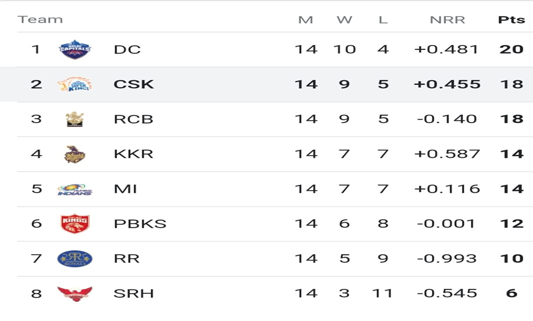
IF A TEAM WINS A MATCH THEN THEY WILL BE GETTING 2 POINTS AND WILL GO TOP OF THE TABLE BY WINNING MORE MATCHES.
IF A TEAM LOOSES A GAME THEN THERE’S NO CHANGE IN POINTS BUT NRR MAY DECREASES BASED ON MATCH RESULT.
NET RUN RATE IS CALCULATED BASED ON RUN SCORED PER OVER/OVERS FACED.
NRR IS CONSIDERED WHEN BOTH THE TEAMS HAVING SAME POINTS IN POINTS TABLE
IF NRR IS MORE THEN BETTER POSITION IN THE POINTS TABLE.
AT THE END OF TOURNMENT THE TEAMS ARE PLACED ON THE POINTS TABLE BASED ON THEIR PERFORMANCES .
TOP 4 TEAMS ARE QUALIFYING TO PALYOFFS ,REST OF THE TEAMS RULED OUT OF THE TOURNMENT.
POINTS TABLE IS THE ONLY WAY TO FINALISE THE BEST TEAMS OF THE TOUNAMENT .

Slide 13
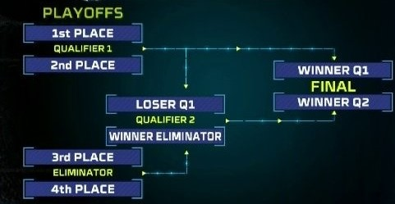

Slide 14
Venues of these matches will be announced in the later part of tournament.
In playoffs there are 2 qualifiers and 1 eliminator and FINALS.
First Qualifier1 will be there ,next Eliminator then Qualifier 2 And at last FINALS.
Qualifier 1 is the match between top 2 teams of the points table.
Winner of this will go directly to finals ,loser will have a chance to play in Qualifier2
So if the teams are at top 2 position in the table then they will not be knocked out of tournament even loosing the Qualifier 1
Eliminator is the match between 3rd and 4th place teams of the points table.
Winner of this match will enter into Qualifier2 to play against the looser of Qualifier1.
Loser of this match will be Eliminated.
Qualifier 2 its match between the winner of Eliminator and Loser of Qualifier 1.
Winner of this match will play the finals and loser will be eliminated .
FINALS : it’s the match between the winners of Qualifier 1 and Qualifier 2.
Winner will be CHAMPIONS of this tournament and loser will be RUNNERS UP.
For every knockout games one extra day will be reserved in the case of play stopped due to rain or like some other challenges..
Only one day will be in reserved when play stopped .no other extensions more than one extra day.
If the league was interrupted or stopped unexpectedly by some reasons like corona ..then the next part of the tournament will be continued form where it was stopped.

Slide 15


